Slide 1
Applications of Computer Science
A new era of development

Slide 2
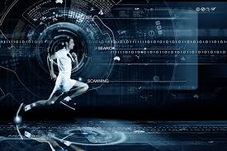

Technology in Sports
Technology has made an impact on many sports in the modern day.
Technology ideas in the world of sport.

Slide 3
Hawk eye Technology
Hawk-eye is the name of a computer and camera system which traces a ball's trajectory.
The Hawk Eye uses a camera taking 600 frames a second on the goal-line.
Which then analyzed by computer and sent to the referee's headset and a clear signal on his watch.
This is also known as GOAL LINE TECHNOLOGY

Slide 4
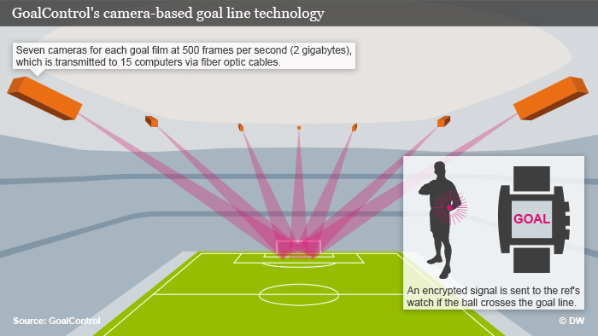
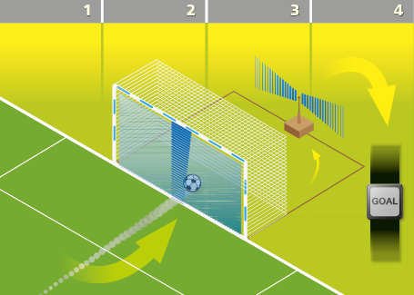
Goal line Technology

Slide 5
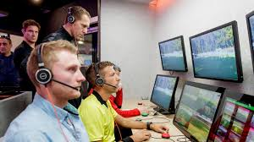

Video Assistant Referee (VAR)
If an error is made by on field umpire, VAR OFFICIALS help him to resolve issue.
This technology increases the beauty of game with no illegal decisions.

Slide 6
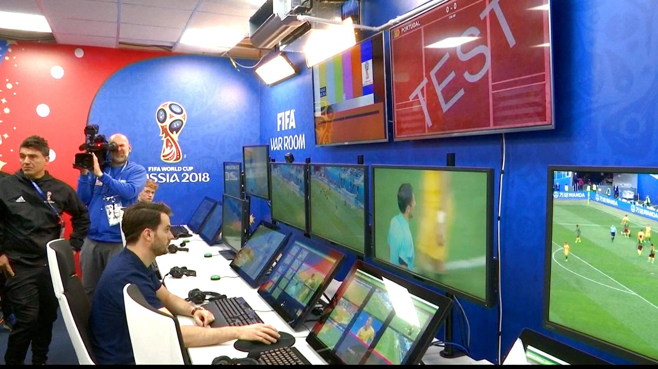
VAR TEAM
OFFICIALS

Slide 7
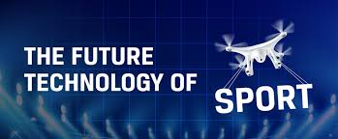
FUTURE OF TECHNOLOGY IN FOOTBALL
In the next few decades robot football could become common.
Shirts might come with tiny cameras and fans could end up controlling players with smart-phones.
It all sounds a little strange but technology is today turning ideas into reality..

Slide 8
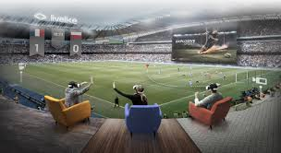
Live & Virtual Stadium Experience
Temperature-controlled continental cheese room will be made.
Boast vibrating seats,because simply watching football is no longer enough.
It will be enhanced using augmented reality apps linked to live in-game data.

Slide 9
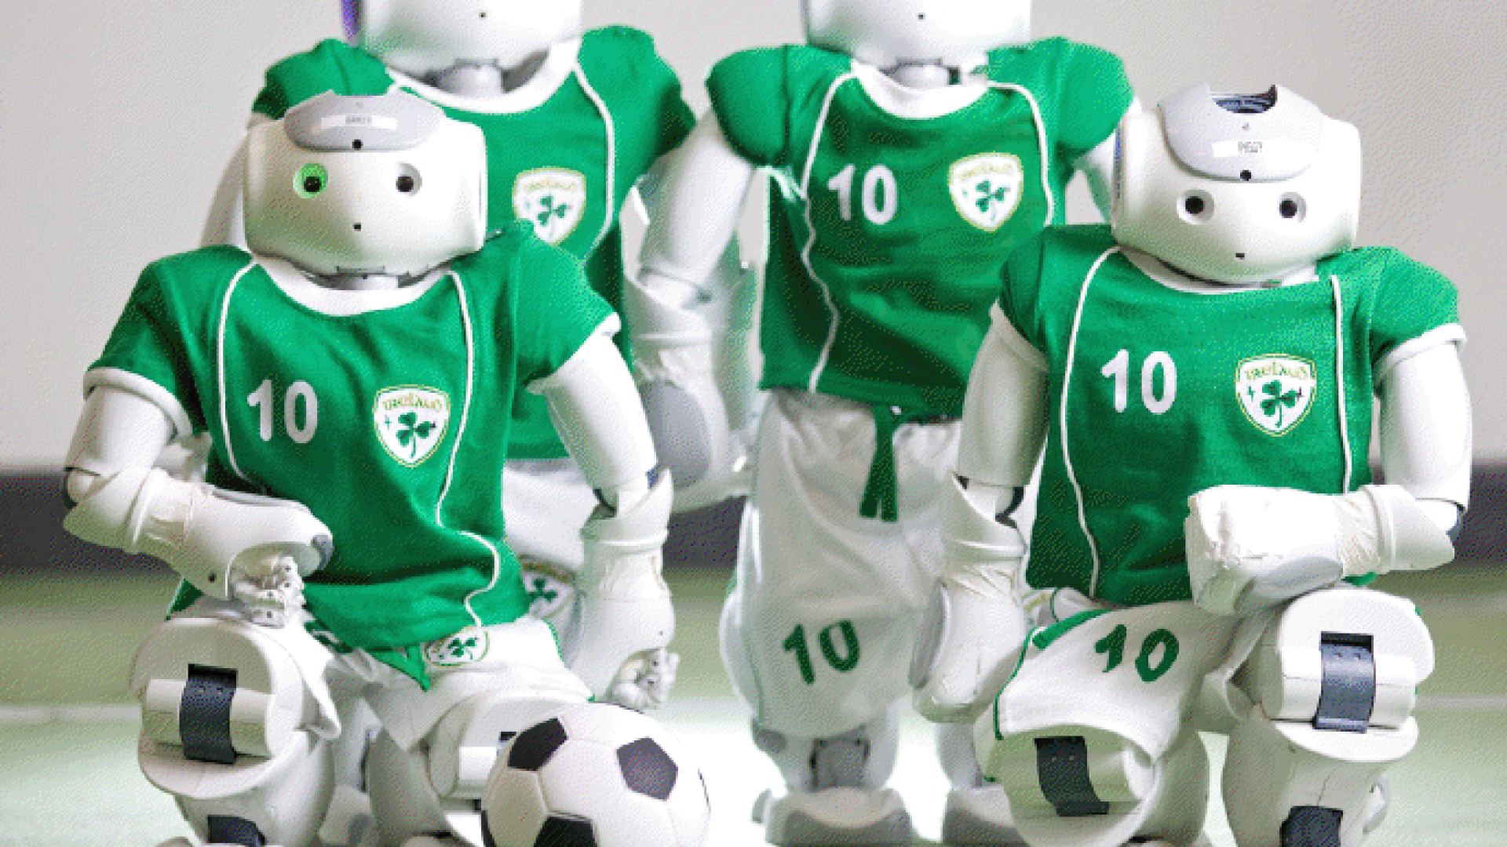
Irish robotics team
Will be like this

Slide 10
DEAR FELLOWS, The Past Cannot Be Changed . The Future is yet in your Power.
THANKYOU

